Slide 1



Slide 2
Members
เอกวัฒน์ ปทุมรังษี 58130500094
Notes:
Next I will explain about Infrastructure .
our team have change infrastructure environment, we have installed nodeJs,nginx into server. to keep connected with Goolge Fit API however we switched to Android Native : Pedometer API to call sensor StepCounter for android device .

Slide 3
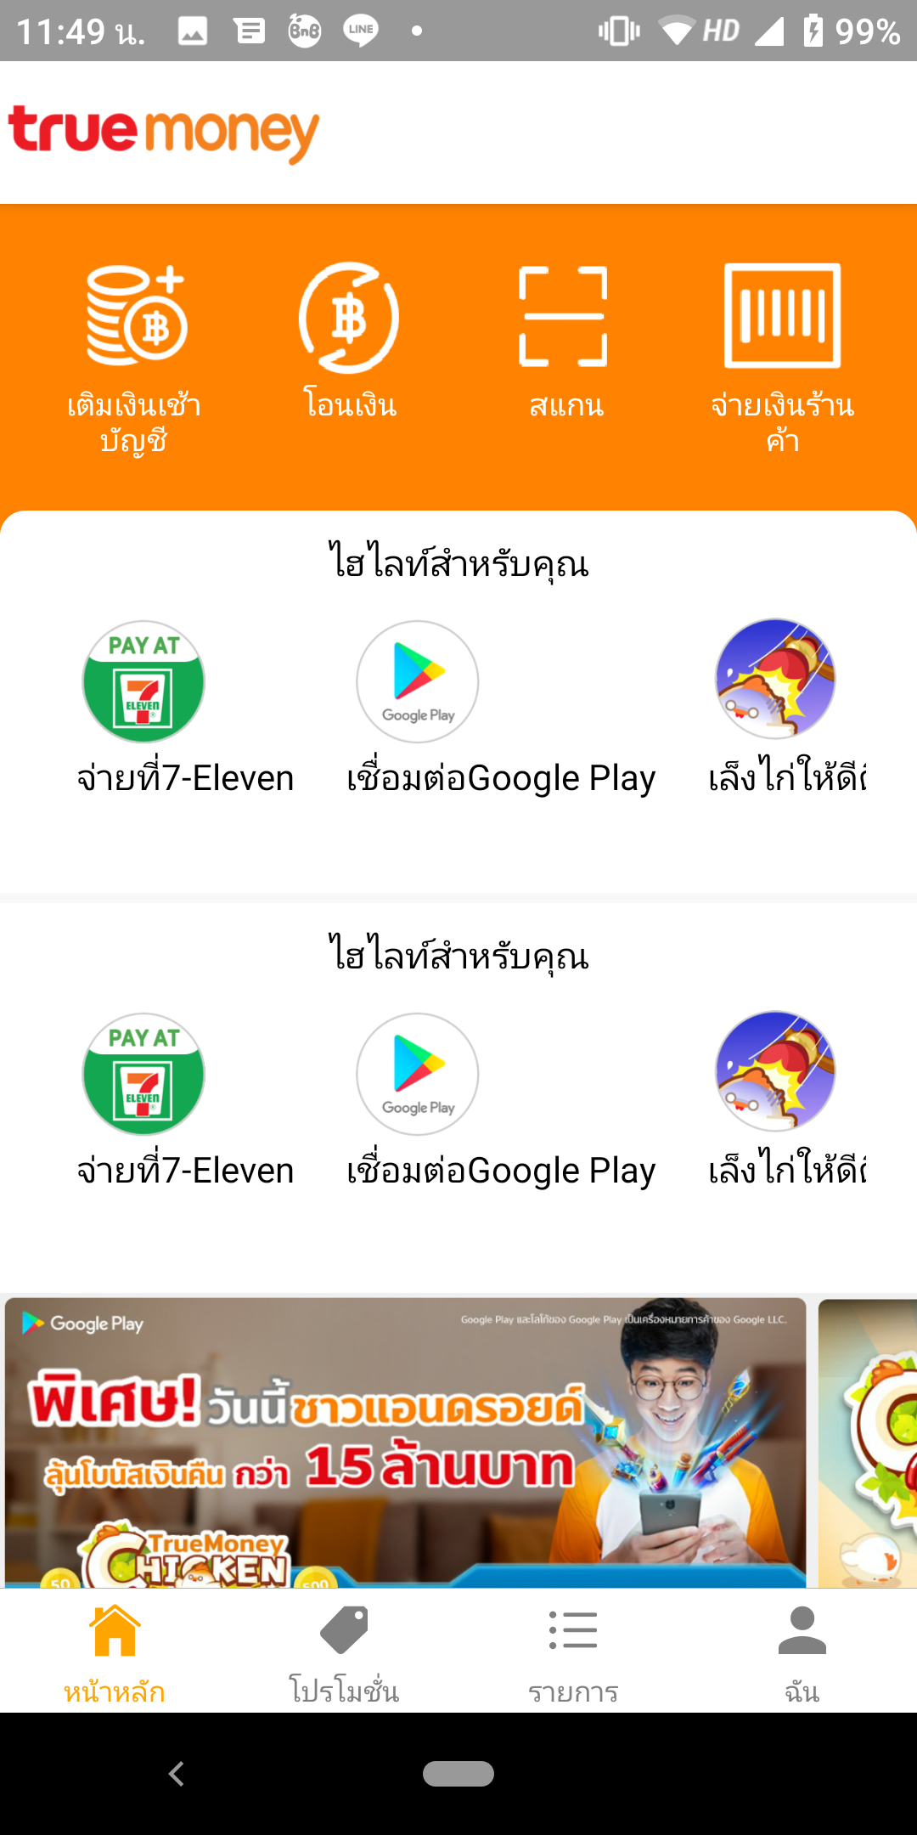
<View>
<Image>
<Text>
</View>
<MenuHighlight />
<ScrollView
<LineItem />
Notes:
Next I will explain about Infrastructure .
our team have change infrastructure environment, we have installed nodeJs,nginx into server. to keep connected with Goolge Fit API however we switched to Android Native : Pedometer API to call sensor StepCounter for android device .

Slide 4

<ScrollView
<LineItem />

Slide 5
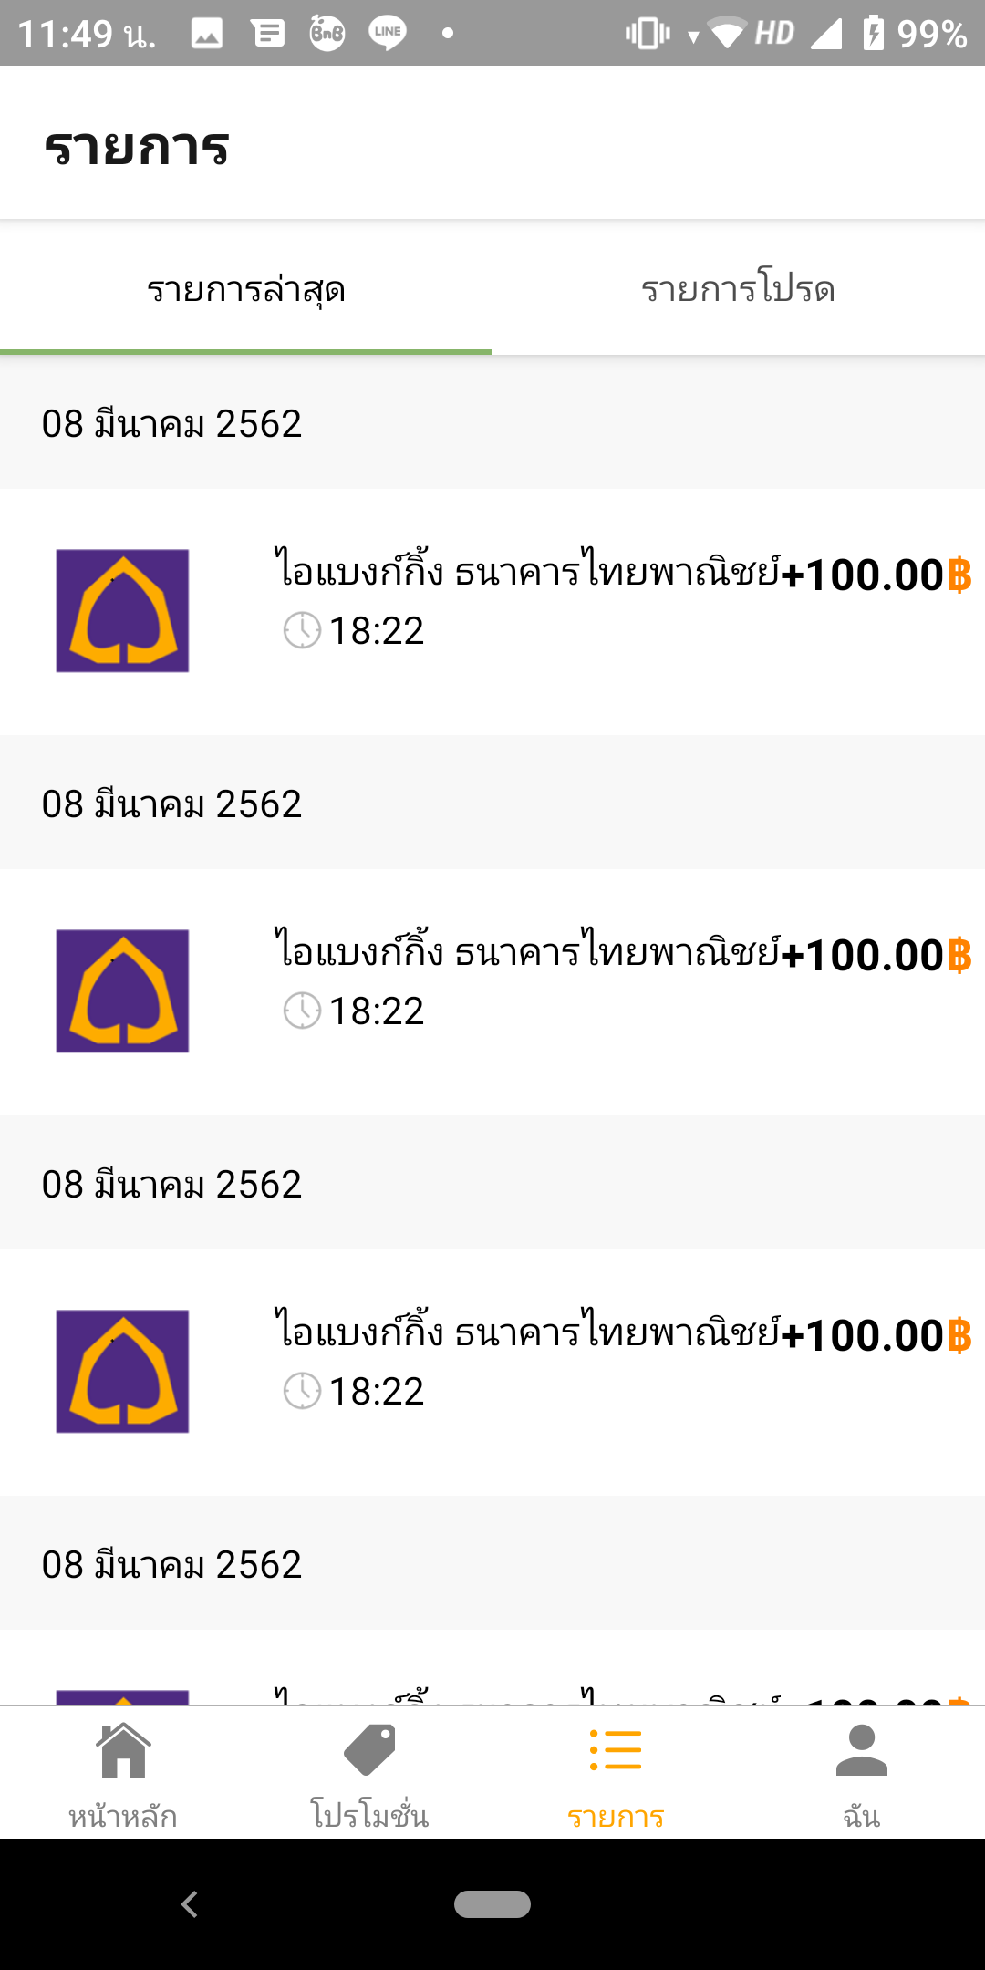
<MaterialTopTabNavigator>
react-navigation
<ScrollView>
<Text>
<View>
<Image>
<Text>
</View>
...

Slide 6
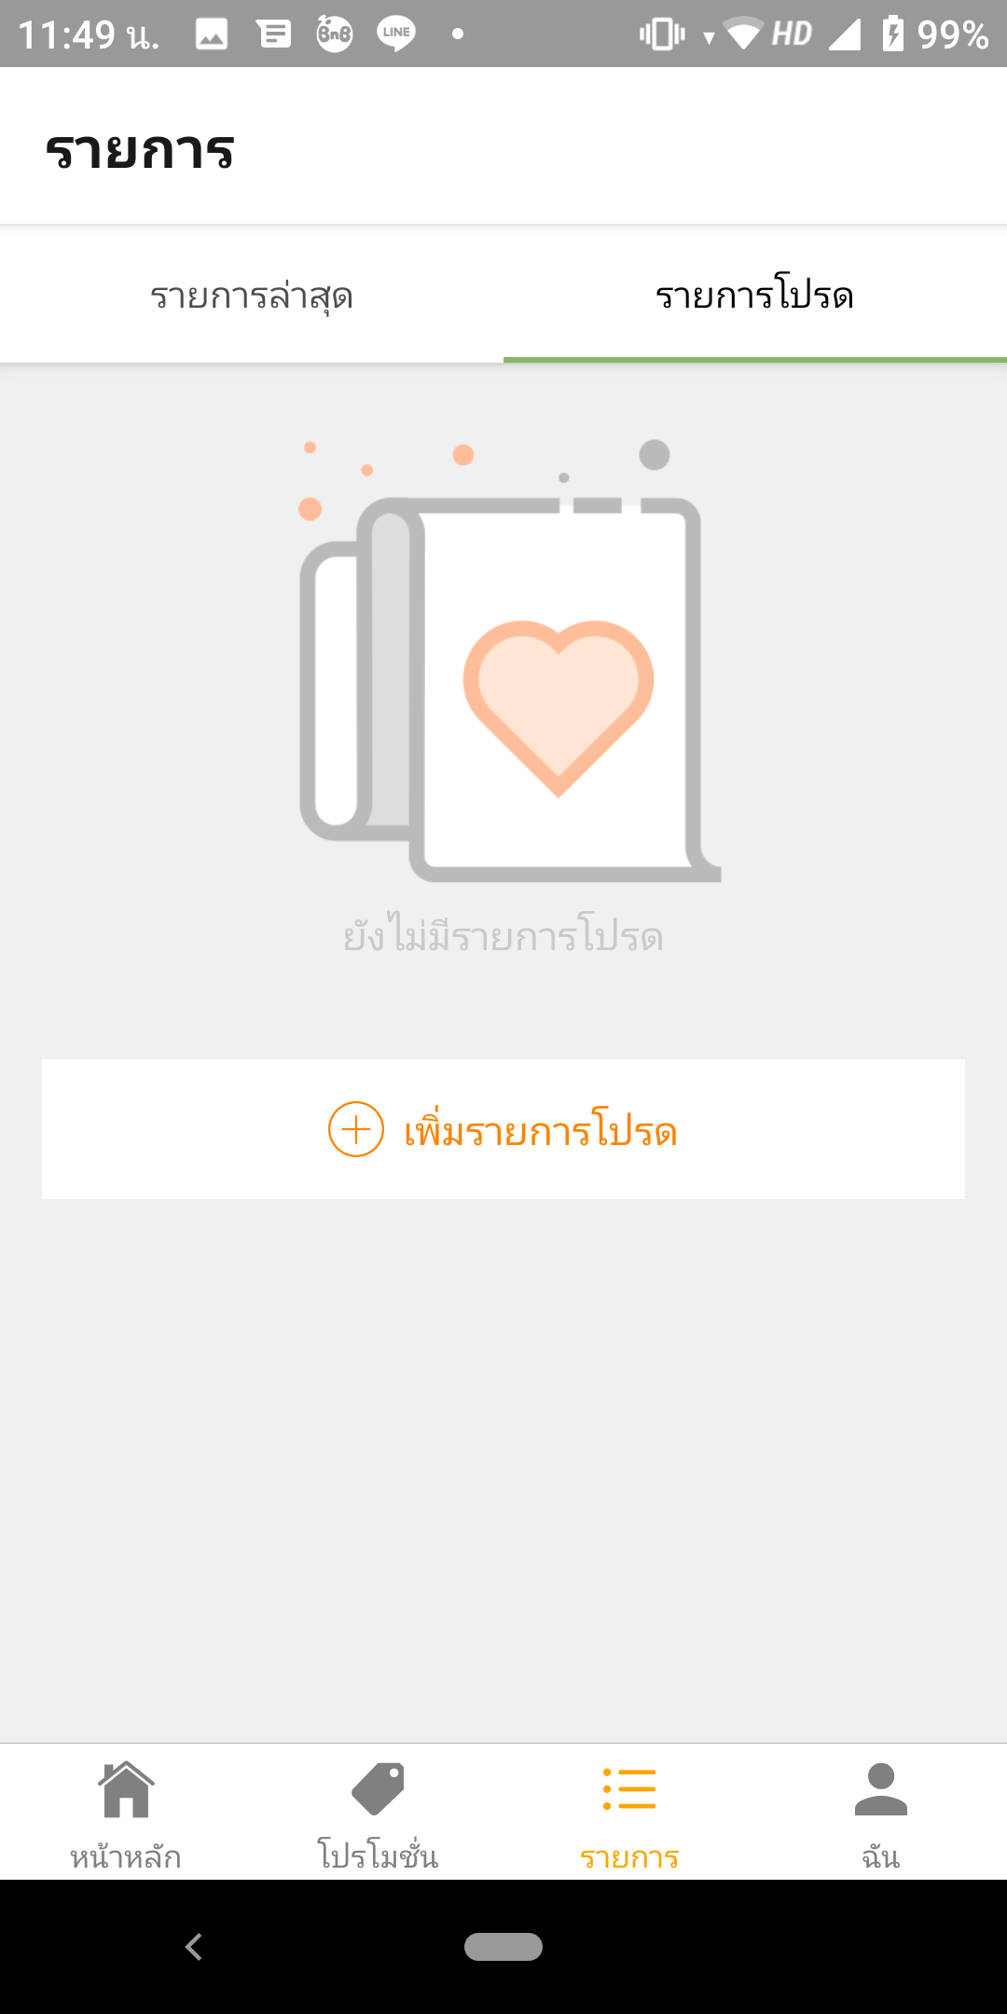
<Image>
<Text>

Slide 7
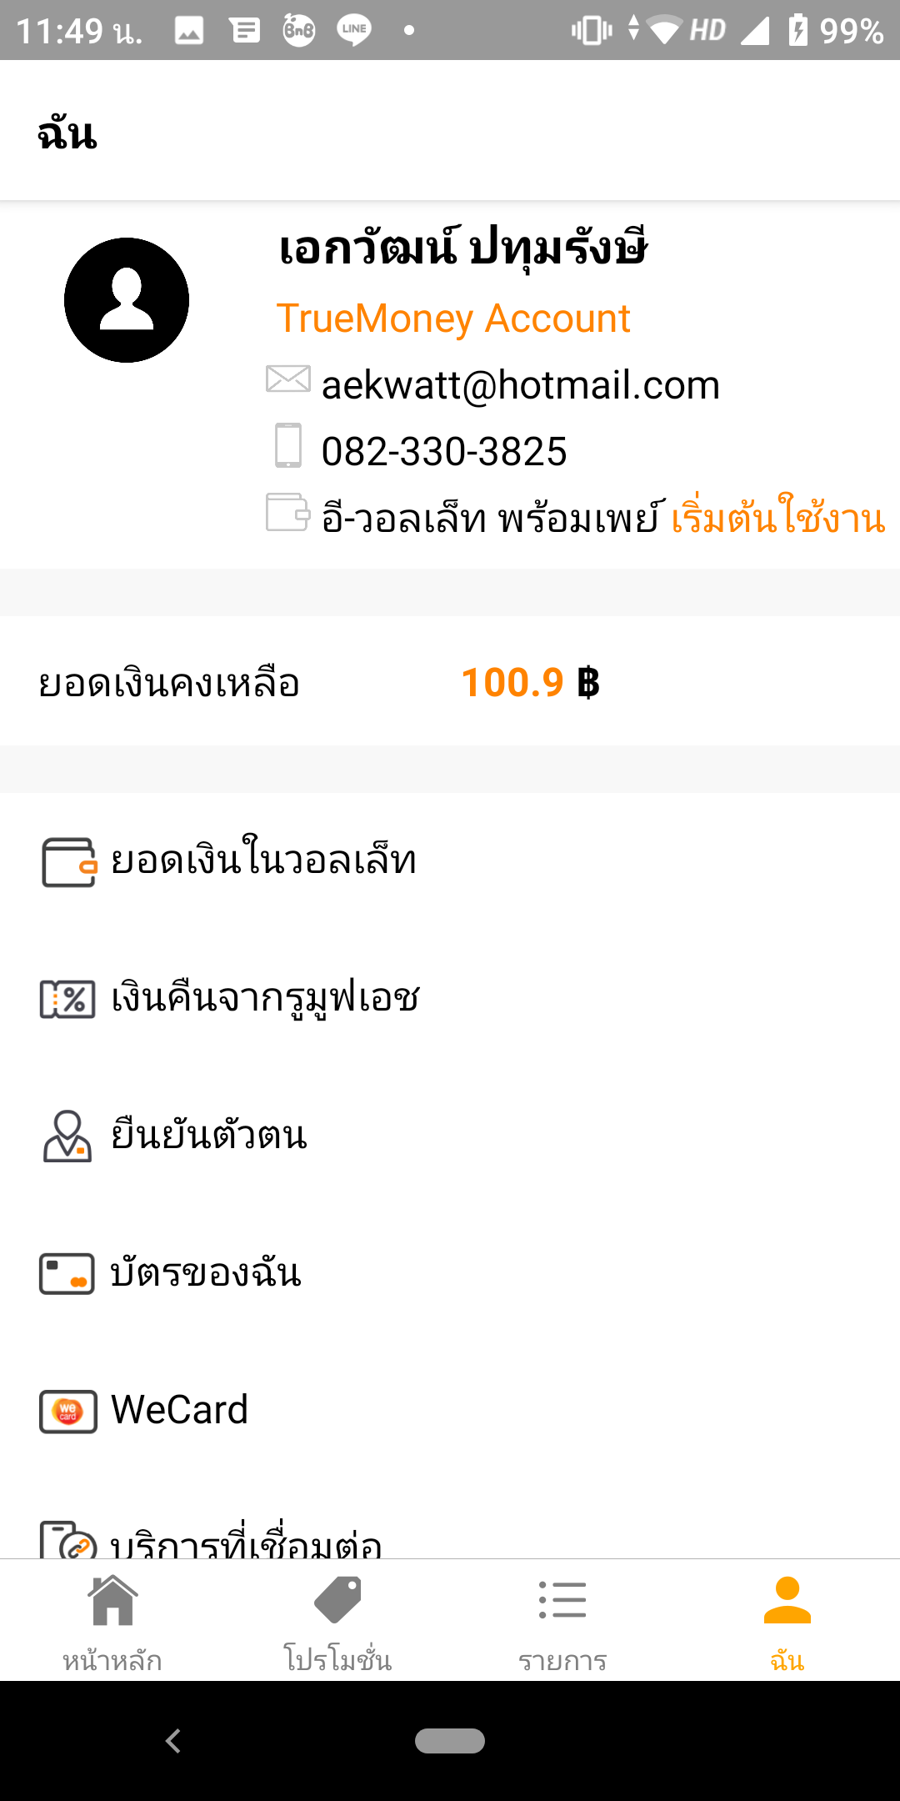
<Image>
<Text>
<User/>
<Image>
<Text>
<List/>
...

Slide 8
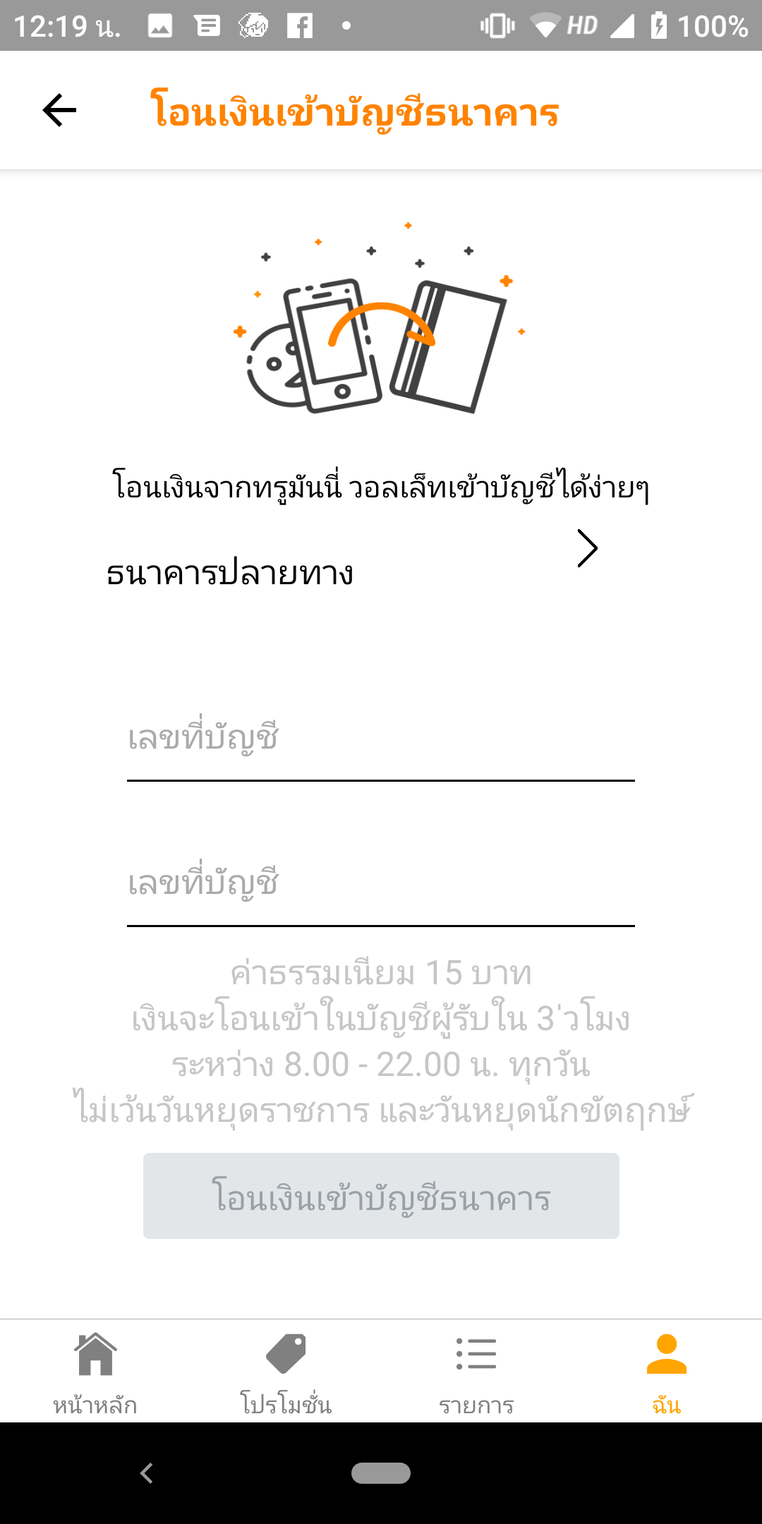
<Image>
<Text>
<FloatingLabelInput/>
<Button/>

Slide 9

THANK YOU

